Slide 1
CMS Contract Conflict of Interest Requirements
Presented by:
Jason Vollmer
Rod Benson
April 21, 2021

Slide 2
Organizational Conflicts of Interest
Organizational conflicts of interest (OCIs): Subpart 9.5 of the Federal Acquisition Regulation (“FAR”) identifies and defines three types of OCIs, including:
  Biased ground rules – Where the contractor’s involvement in defining requirements, preparing work statements, developing business cases, etc., could skew a competition in its favor and/or could provide it with an unfair advantage in the competition for the underlying requirements. (FAR 9.505-1, 9.505-2)
  Impaired objectivity – Where the contractor’s judgment/objectivity in performing the contract may be impaired because the performance could have an affect on other activities or interests of its business. (FAR 9.505-3)
  Unequal access to information – Where the contractor’s access to non-public information (i.e., source selection or proprietary) in contract performance may give it an unfair advantage in future competitions. (FAR 9.505-4)
In evaluating conflicts of interest, the Government will consider the financial interests with affiliated entities.

Slide 3
Two Types of COIs
There are two broad categories of COIs:
  Organizational conflicts of interest (OCI)
  Personal conflicts of interest (PCI)

Slide 4
Contracting Officer Responsibilities for COIs
A contracting officer (“CO”) has two distinct duties under FAR 9.504(a):
  the duty to identify and evaluate potential OCIs; and,
  the duty to avoid, neutralize, or mitigate significant potential OCIs before contract award

Slide 5
Importance of COIs for CMS
COIs are especially important for CMS because of:
  Regulatory and statutory authorities
  Protests
  Contractors perform inherently governmental functions
  Contractors act in a fiduciary capacity
  Congressional, GAO, OIG and other oversight

Slide 6
Brief History of CMS COIs
Medicare intermediary contracts under Section 1816 of the Social Security Act and carrier contracts under Section 1842, in effect from 1965 until 2005 were unique:
  Nomination process under Section 1816
  Section 1842 provided that contracts were noncompetitive
  These contracts were the primary vehicles for the administration of the Medicare program
The contracts provided that a contractor could not use its position as an intermediary or carrier to further its private business interests
The first COI issues involved cost report preparation and billing services

Slide 7
Statutory COI Requirements for CMS Programs
Quality Improvement Organizations
Medicare Integrity Program (Includes Recovery Audit Contractors)
Qualified Independent Contractors
Medicare Administrative Contractors

Slide 8
Quality Improvement Organizations
Section 1153 (b) applies to contracts with Quality Improvement Organizations. It provides that the Secretary shall not contract:
  With an entity which is, or is affiliated with an entity which makes payments to a provider whose health care services would be reviewed by such entity if it entered into a QIO contract unless no other entities are available in the area
  With an entity which is, or is affiliated with (through management, ownership, or common control), a health care facility within the QIO area. An entity is affiliated with a health care facility by reason of management, ownership, or common control if the management, ownership, or common control consists of more than 20 percent of the members of the governing board of the entity being affiliated.
  QIO contracts are subject to Federal contract authorities unless the Secretary determines that “any provision of law relating to the making, performance, amendment, or modification of contracts of the United States as the Secretary may determine to be inconsistent with the purposes of this part.”

Slide 9
Medicare Integrity Program
Statutory Authority
Section 1893 of the Social Security Act established the Medicare Integrity Program. This serves as the governing authority for the Unified Program Integrity Contracts (UPIC) and its predecessor contracts. Section 1893 is also the authority for the Recovery Audit Contracts.
Section 1893(d)(1) provides:
  (d) Process for Entering Into Contracts.—The Secretary shall enter into contracts under the Program in accordance with such procedures as the Secretary shall by regulation establish, except that such procedures shall include the following:
    Procedures for identifying, evaluating, and resolving organizational conflicts of interest that are generally applicable to Federal acquisition and procurement.

Slide 10
Medicare Integrity Program
Regulatory Authority
42 CFR 421.302(a)(3) provides:
  (a) CMS may enter into a contract with an entity to perform the functions described in § 421.304 if the entity meets the following conditions:
    (3) Complies with conflict of interest provisions in 48 CFR chapters 1 and 3, and is not excluded under the conflict of interest provision at § 421.310.
42 CFR 421.310 provides:
  Offerors for MIP contracts and MIP contractors are subject to the following:
    (a) The conflict of interest standards and requirements of the Federal Acquisition Regulation (FAR) organizational conflict of interest guidance specified under 48 CFR subpart 9.5.
    (b) The standards and requirements as are contained in each individual contract awarded to perform section 1893 of the Act functions.

Slide 11
Medicare Integrity Program
Regulatory Authority
42 CFR 421.312, “Conflict of interest resolution”, provides:
  Review Board. CMS may establish and convene a Conflicts of Interest Review Board to assist the contracting officer in resolving organizational conflicts of interest.
  (b) Resolution - (1) Pre-award conflicts. Resolution of an organizational conflict of interest is a determination by the contracting officer that one of the following has occurred:
      (i) The conflict is mitigated.
      (ii) The conflict precludes award of a contract to the offeror.
      (iii) It is in the best interest of the government to award a contract to the offeror (in accordance with 48 CFR subpart 9.503) even though a conflict of interest exists.
    (2) Post-award conflicts. Resolution of an organizational conflict of interest is a determination by the contracting officer that one of the following has occurred:
      (i) The conflict is mitigated.
      (ii) The conflict requires that CMS modify an existing contract.
      (iii) The conflict requires that CMS terminate or not renew an existing contract.
      (iv) It is in the best interest of the government to continue the contract even though a conflict of interest exists.

Slide 12
Medicare Administrative Contractor
Section 1874A of the Social Security Act provides the authority for the Medicare Administrative Contractors (MAC). Section 1874A(2) provides that an entity is eligible to enter into a MAC contract if:
  (A) the entity has demonstrated capability to carry out such function;
  (B) the entity complies with such conflict of interest standards as are generally applicable to Federal acquisition and procurement;
  (C) the entity has sufficient assets to financially support the performance of such function; and
  (D) the entity meets such other requirements as the Secretary may impose.

Slide 13
Qualified Independent Contractor
Section 1869(c) provides the authority for the Secretary to enter into contracts with Qualified Independent Contractors. Section 1869(c)(3)(k) imposes the following requirements on QIC contracts:
  (K) Independence requirements.—
    (i) In general.—Subject to clause (ii), a qualified independent contractor shall not conduct any activities in a case unless the entity—
      (I) is not a related party (as defined in subsection (g)(5));
      (II) does not have a material familial, financial, or professional relationship with such a party in relation to such case; and
      (III) does not otherwise have a conflict of interest with such a party.

Slide 14
FAR Subpart 9.5
FAR Subpart 9.5, “Organizational and Consultant Conflicts of Interest”:
  (a) Prescribes responsibilities, general rules, and procedures for identifying, evaluating, and resolving organizational conflicts of interest
  (b) Provides examples to assist contracting officers in applying these rules and procedures to individual contracting situations

Slide 15
FAR Subpart 9.5
FAR 9.502(c), “Applicability”, provides:
  An organizational conflict of interest may result when factors create an actual or potential conflict of interest on an instant contract, or when the nature of the work to be performed on the instant contract creates an actual or potential conflict of interest on a future acquisition. In the latter case, some restrictions on future activities of the contractor may be required.

Slide 16
FAR Subpart 9.5
FAR 9.503, “Waiver”, provides:
  The agency head or a designee may waive any general rule or procedure of this subpart by determining that its application in a particular situation would not be in the Government’s interest. Any request for waiver must be in writing, shall set forth the extent of the conflict, and requires approval by the agency head or a designee. Agency heads shall not delegate waiver authority below the level of head of a contracting activity.

Slide 17
FAR 9.504
FAR 9.504, “Contracting officer responsibilities” provides:
  (a) Using the general rules, procedures, and examples in this subpart, contracting officers shall analyze planned acquisitions in order to-
    (1) Identify and evaluate potential organizational conflicts of interest as early in the acquisition process as possible; and
    (2) Avoid, neutralize, or mitigate significant potential conflicts before contract award.

Slide 18
FAR Subpart 9.5
FAR 9.504(e) provides:
  (e) The contracting officer shall award the contract to the apparent successful offeror unless a conflict of interest is determined to exist that cannot be avoided or mitigated. Before determining to withhold award based on conflict of interest considerations, the contracting officer shall notify the contractor, provide the reasons therefor, and allow the contractor a reasonable opportunity to respond. If the contracting officer finds that it is in the best interest of the United States to award the contract notwithstanding a conflict of interest, a request for waiver shall be submitted in accordance with 9.503. The waiver request and decision shall be included in the contract file.

Slide 19
FAR Subpart 9.5
FAR 9.505, “General rules”, provides:
The exercise of common sense, good judgment, and sound discretion is required in both the decision on whether a significant potential conflict exists and, if it does, the development of an appropriate means for resolving it. The two underlying principles are-
(a) Preventing the existence of conflicting roles that might bias a contractor’s judgment; and
(b) Preventing unfair competitive advantage. In addition to the other situations described in this subpart, an unfair competitive advantage exists where a contractor competing for award of any Federal contract possesses-
  Proprietary information that was obtained from a Government official without proper authorization; or
  Source selection information (as defined in 2.101) that is relevant to the contract but is not available to all competitors, and such information would assist that contractor in obtaining the contract.

Slide 20
Resolution Options
(Pre-Solicitation, Pre-Award, Post-Award)
Avoidance
To prevent the occurrence of a COI through actions such as exclusion of sources or modification of requirements. Avoidance precludes the conflict.
Neutralize
To counteract through a specific action the effects of potential or actual COI. The conflict remains but the impact of the conflict has been negated.
Mitigate
To reduce the effects of a COI to an acceptable level of risk so that the Government’s interest with regard to fair competition and/or contract performance are not impaired. The conflict remains but action was taken that minimizes the impact of the conflict to an acceptable level of risk.
Waive
The agency head or a designee may waive any general rule or procedure of this subpart by determining that its application in a particular situation would not be in the Government’s interest. Any request for waiver must be in writing, shall set forth the extent of the conflict, and requires approval by the agency head or a designee. Agency heads shall not delegate waiver authority below the level of head of a contracting activity.

Slide 21
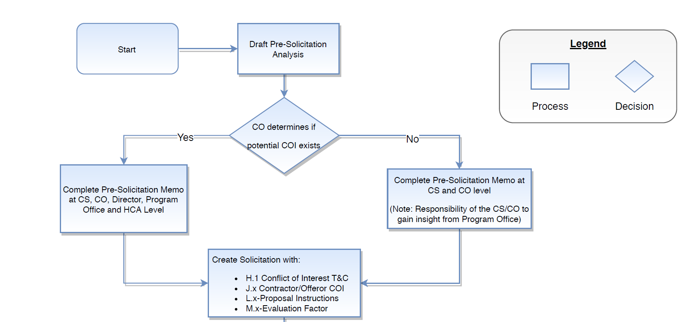
Understanding the CMS Process – Pre Solicitation

Slide 22
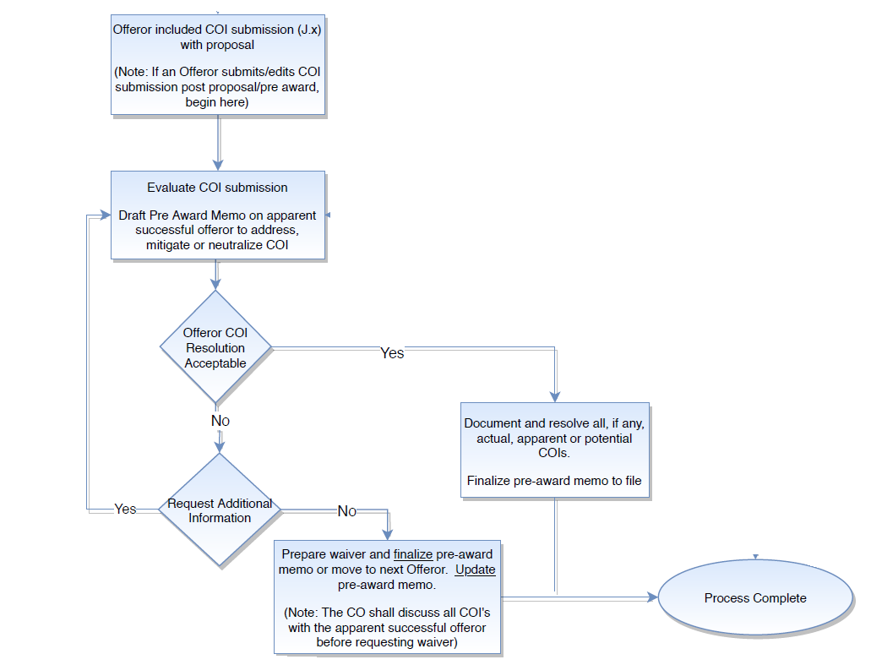
Understanding the CMS Process

Slide 23
CMS COI Terms and Conditions
Changes effective September 2020
Review of COI matters handled at the CMS Group level
One T&C for all contracts
  Streamlined by eliminating redundant FAR information
  Identification and mitigation strategy requirements of the contractor
Separation of “Ethics” and “Conflict of Interest”
  FAR 52.203, Contractor Code of Business Ethics
  Certification requirement eliminated
Removal of annual audit requirement
J.y Attachment – Personal Conflict of Interest, removed from solicitations

Slide 24
CMS COI Terms and Conditions
a. General: The contractor and the services provided under this contract shall be free, to the greatest extent possible, of all Organizational and Personal Conflicts of Interest. Consistent with these terms and conditions, all references to Organizational and/or Personal Conflicts of Interests will be referred to individually or collectively, as Conflicts of Interest (COI). Except as defined by these terms and conditions and in accordance with FAR 9.503, the Contracting Officer shall not maintain a contract with a contractor the Contracting Officer (CO) determines has, or has the potential for, an unresolved COI.

Slide 25
CMS COI Terms and Conditions
c. Significant Potential Conflict of Interest:
Nature of Conflict: Although not all inclusive, the following are considered to be an actual, potential or apparent COI with the work to be performed under this contract. The contractor shall promptly notify the CO if it is an entity, or affiliated with an entity, where any of the following circumstances exist:
a) Biased Ground rules, impaired objectivity or unequal access to information as explained in the definitions above and/or;
b) Within the three types of conflicts of interest, the CO has identified the following specific circumstances of conflicts:
<Program/Contract Specific COI language will be inserted here>
Proposed Restraint on Future Contractor Activities: CMS is proposing to restrain future contractor activities as follows:
<Program/Contract Specific COI language will be inserted here>

Slide 26
CMS COI Terms and Conditions
d. Conflict of Interest Oversight and Mitigation Plan:
1. Conflict of Interest Oversight Program: The contractor shall maintain an effective COI Oversight Program throughout the performance of the contract which includes procedures to monitor and disclose all Organizational and Personal Conflicts of Interest. A COI oversight program should include the monitoring of personal conflicts of interest such as, but not limited to:
a) Managers or Key Personnel who would be, or are involved with, the performance of this contract;
b) Governing Body Members (e.g., Board of Directors; Trustees); and
c) Principals of the organization as defined by FAR 52.203-13, Contractor Code of Business Ethics and Conduct.

Slide 27
CMS COI Terms and Conditions
2. Mitigation Plan: At any time during the performance of the contract if an actual, potential, or apparent COI is identified whether by the CO, the contractor or otherwise, the contractor shall submit a mitigation plan (J.x Contractor/Offeror COI Submission Template) within 30 days unless otherwise specified by the CO. It is the contractor’s responsibility under the terms and conditions to provide timely notification to the CO those COIs that are self-identified. The CO will notify the contractor regarding the specifics for submission. The Government will review the submission at which time a determination will be made whether a COI has been satisfactorily mitigated or if further action is necessary and will notify the contractor accordingly. In cases where a COI cannot be, or has not been, mitigated to the Government’s satisfaction, the Government may take the following actions (this list is not all inclusive):
a) Request a waiver in accordance with FAR 9.503 Waiver, from the Head of the Contracting Activity;
b) Make changes to the requirements of the contract;
c) Require a subcontractor change (if the conflict lies with the subcontractor); and/or
d) Terminate the contract in whole or in part.

Slide 28
CMS COI Terms and Conditions
e. Subcontractor Flow-Down Terms and Conditions: The prime contractor is responsible for avoiding, neutralizing and mitigating all actual, potential, or apparent COIs of its subcontractors, in accordance with these terms and conditions. Therefore, the prime contractor shall flow-down terms and conditions H.1 Conflict of Interest and Compliance, of this contract in all subcontracts. For subcontractors, wherever the term “contractor” is used, insert “subcontractor.”

Slide 29
Typical CMS Restrictions
A Medicare Administrative Contractor may not be a Recovery Audit Contractor (RAC), Qualified Independent Contractor (QIC), Quality Improvement Network (QIN) - Quality Improvement Organization (QIO) or End State Renal Disease (ESRD) Audit Contractor
Perform its contractual requirements related to another effort performed by an affiliated company.
The same contractor cannot be the Development, Implementation and/or Testing/Evaluation Contractor

Slide 30
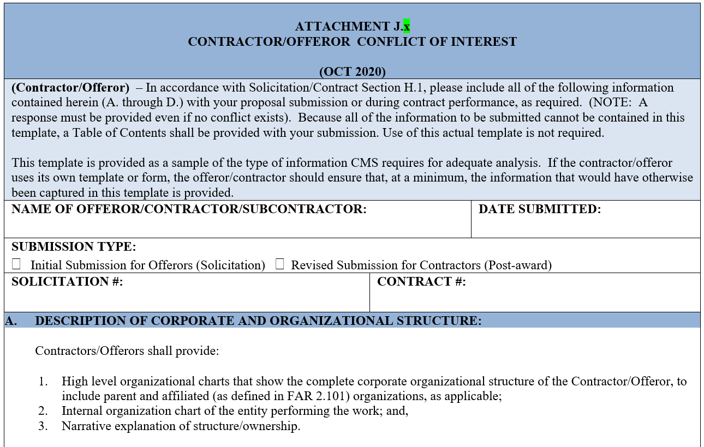
Attachment J.x

Slide 31
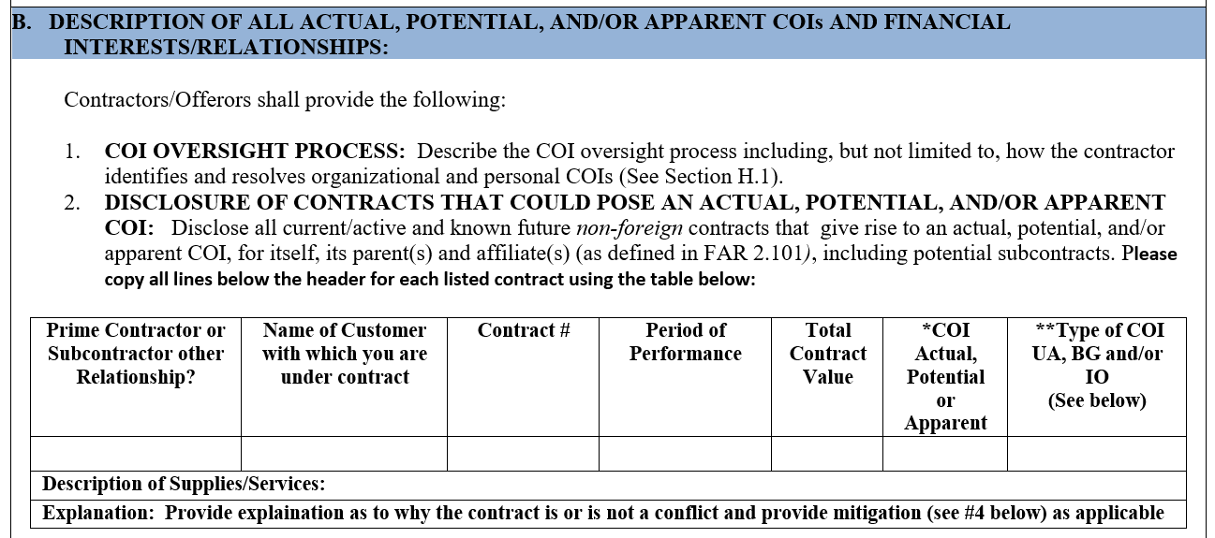
Attachment J.x

Slide 32
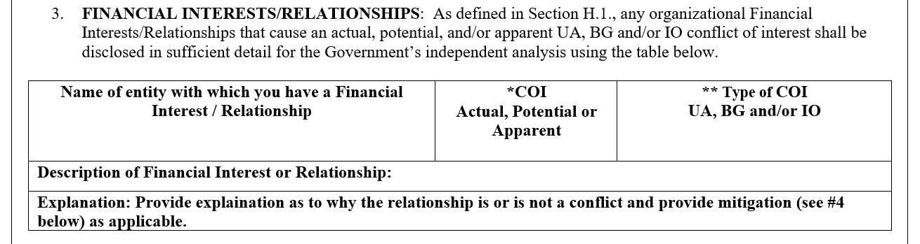
Attachment J.x

Slide 33
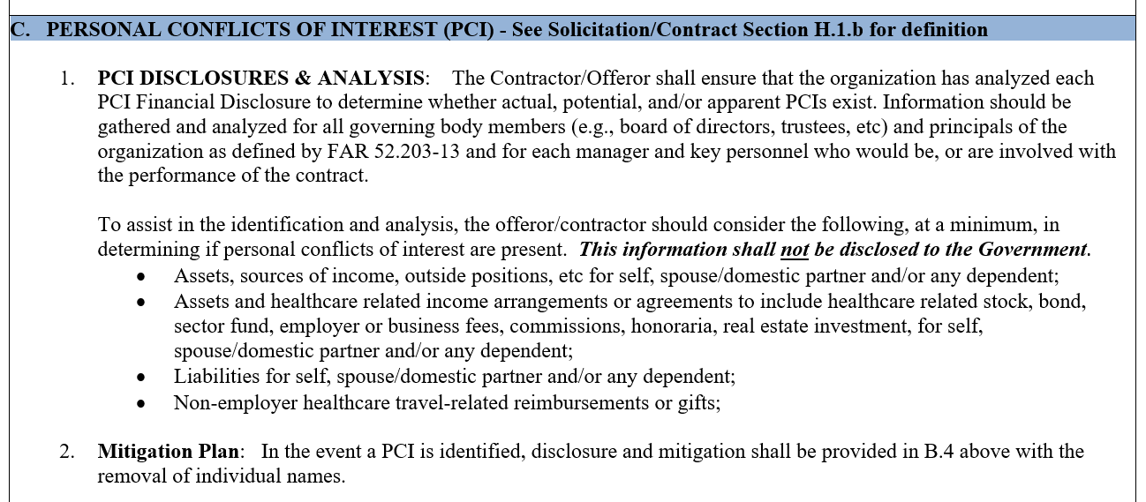
Attachment J.x

Slide 34
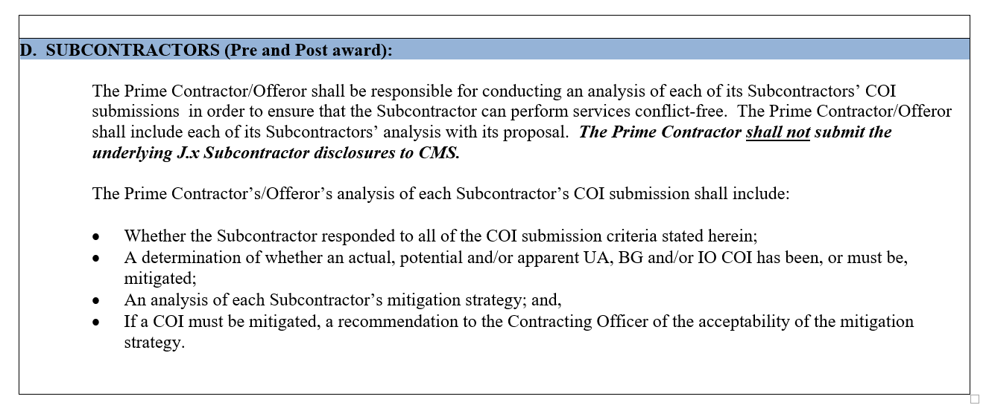
Attachment J.x

Slide 35
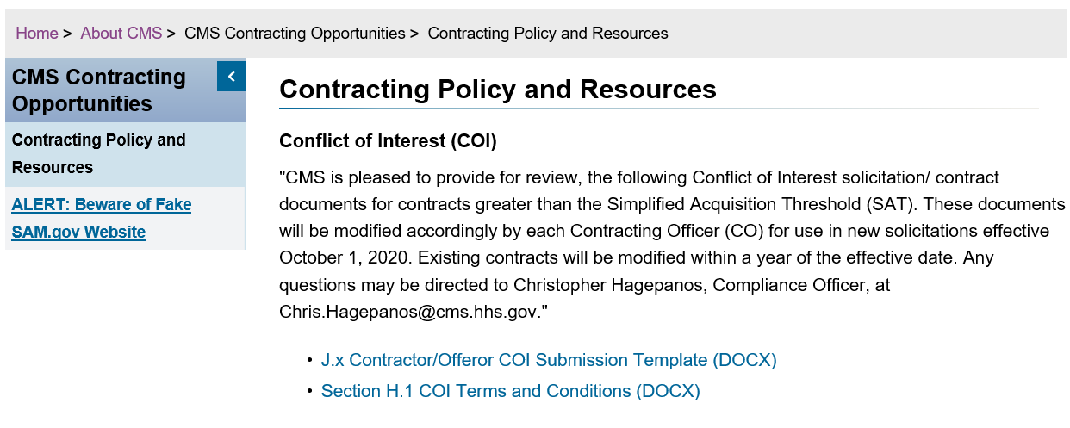
OAGM Resource Page
CMS link to OAGM webpage

Slide 36
Questions?

