Slide 1



CMS Reverse Industry Day
CMS Reverse Industry Day
Interpreting Requirements and Evaluation Criteria: Industry Perspectives on “Best Value” Procurements
July 31, 2024

Slide 2
AGENDA
Part 1: The Role of Pre-RFP Communication and Engagement to Best Value Procurements
  Industry’s Approach to Procurements
  Importance and Role of the Forecast and Teaming / Joint Ventures
  Incentivizing Competition and Using Market Research to Improve the RFP
Part 2: How Industry Analyzes and Responds to Best Value RFPs
  Overall RFP Concerns
  Challenges and Impacts in Section M (Evaluation Criteria) and Section L (Instructions)
Break – 5 minutes
Part 2: How Industry Analyzes and Responds to Best Value RFPS
  Challenges and Impacts in Section C (Statement of Work) and Section B (Pricing)
  Industry’s Price to Win Strategy
  Multi-Step Evaluations and “Show Me Don’t Tell Me” Evaluation Methodologies
Question & Answer Session
Response and Closing by the CMS

Slide 3


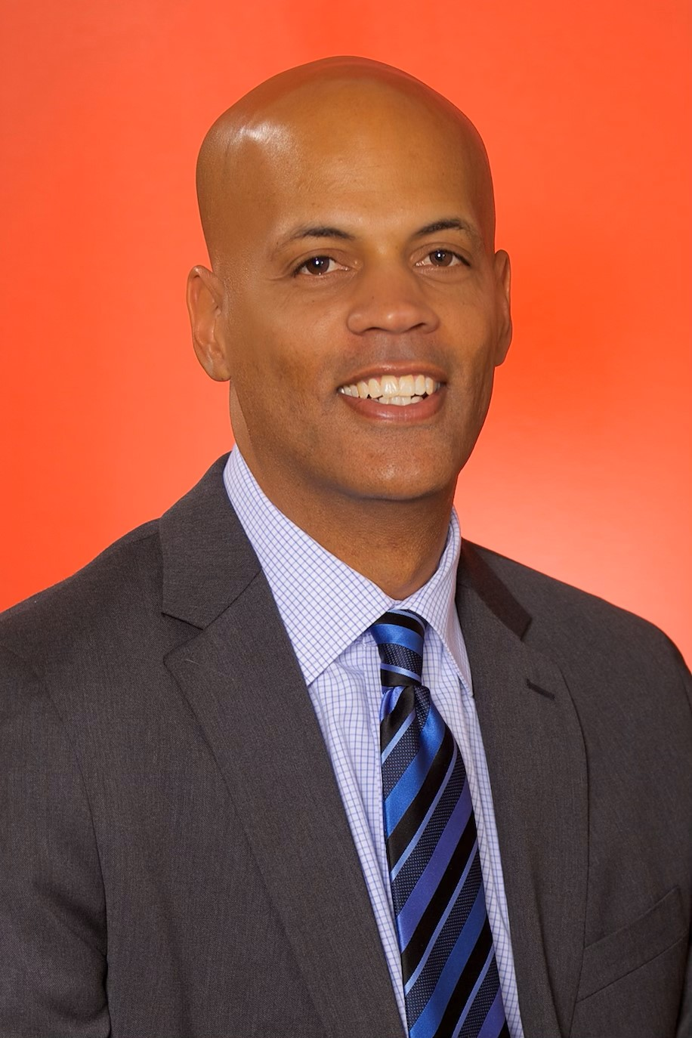




Meet the Presenters
Manu Uppal
CEO
Tyrula LLC
Tracy Mills
CEO and Founder
J29 Inc.
Corey Cooke
CEO
Signature Consulting Group
Lisa Rosenthal
Vice President
Optum Serve
Dominick Esposito
Vice President
Westat
John Roman
Vice President of Contracts, Procurement, and Pricing
ECS Federal

Slide 4

Part 1: The Role of Pre-RFP Communications and Engagement to Best Value Procurements
Part 1:
The Role of Pre-RFP Communication
and Engagement to Best Value Procurements

Slide 5
Acquisition Planning Considerations for Best Value Procurements
Incentivize industry investment in CMS procurements
Incentivize competition (e.g., new entrants, increase small business participation, etc.)
Reduce inquiries, bids, and investment by the wrong bidders
  Ensure manageable number of proposals for CMS review
  Save time and resources for CMS and industry that could be better invested in other needs
Ensure industry provides cost effective and quality solutions on time and within budget
Allow industry to offer new ideas, innovation, and/or new ways of doing business that will achieve desired outcomes
Develop evaluation criteria that allows CMS to conduct a meaningful “trade off” between performance and cost and other relevant factors / subfactors

Slide 6
Industry’s Approach to Procurements
Each contract bid is an INVESTMENT of company funds to cover the hours that each employee expends to pursue and respond to a proposal.
  Firms commonly spend around 1-2% of the total contract value to pursue the work.
Companies often require 12-18 months of “capture” work in advance of an RFP release to understand:
  Requirements
  Recruit Key Personnel
  Build a team of subcontractors or form a joint venture
  Vet technology solutions
  Draft a technical approach
  Understand the competition
  Determine Price to Win
Firms cannot create an innovative solution and compliant, competitive proposal in the 2-4 weeks typically allocated for response.

Slide 7
Industry’s Approach to Procurements Continued
Proposals require significant time and effort with limited resources (both people and $$$)
  Involves technical, contracts, compliance, HR, proposal writers, orals coaches, legal, and financial experts. Staff may already have commitments on existing billable contract work.
  Managing resources for proposal development is challenging, particularly for small businesses.
Companies use an objective process to compare and choose between competing investments.
  Small businesses can make decisions more quickly but have limited funds for new bids.
  Large companies often require formal “Step Reviews” to commit Bid & Proposal funds in pursuit of opportunities.
  Companies ultimately make a “Bid or No Bid” decision, choosing opportunities that offer the highest probability of win (p-win) and return on investment (ROI.)
  Decisions are largely driven by what information is known or unknown.

Slide 8
Role and Importance of Forecasts
Attract Industry Investment and Competition
Industry chooses which agencies and opportunities to invest limited $ based upon the level of detail provided, fit to capabilities, and time to prepare. Early communication increases likelihood that industry invests in CMS’ mission needs, particularly for small businesses with limited resources.
Quality Proposals /Better Solutions
Forecasts give industry time to work with government to understand requirements, determine the best solution, and to develop innovation if desired.
Right Solution Team
Early forecasts allow companies to assess and meet teaming needs. Teaming is competitive and best teams are sought early.
Reduce Inquiries, Bids, and Investment by Wrong Offerors
Early forecasts with clear descriptions, contract vehicle, and acquisition strategy allow companies to stop pursuing opportunities for which they are not eligible or a poor fit. This results in fewer low-quality proposals for the gov’t to review and fewer calls to CMS.

Slide 9
Teaming and Mentor Protégé Joint Ventures (MPJVs)
Teaming is a critical part of a bidder’s proposed solution and may serve as the key differentiator during the government’s best value trade off analysis (e.g., key personnel, certifications, past performance, financial systems, customer knowledge, management, ability to transition, technical capabilities)
JVs are very different than typical contractor team agreements (e.g., prime / sub-contractor relationship). JVs are new separate legal entities that are formed as LLCs under state laws and require the following:
  Articles of Incorporation, Operating Agreements, application documentation
  JV’s must have their own sam.gov registration
  Mentor protégé agreement detailing each parties' commitments must be approved by SBA first
Why companies form MPJVs?
  An SBA approved mentor and its protégé can form a JV as a small business for any small business contract, provided the protégé individually qualifies as small. The JV may also pursue any type of set-aside contract for which the protégé qualifies, including contracts set aside for 8(a), SDVOSB, woman-owned, and HUBZone businesses.
  Large companies in a MPJV are allowed greater work share of small business set aside work
  Small businesses benefit from mentoring, financial assistance, business development support, guidance on business management systems, human resource sharing, and the mentor’s past performance.
Early and frequently updated forecasting of small business opportunities is critical to the success of these partnerships!
  A MPJV can take 6+ months to set up and receive approval
  MPJVs have a time limit so they try to pursue as many contracts together as possible during their existence

Slide 10
What Signals Are You Sending to Industry?
Industry’s interpretation of the RFP and the government’s requirement starts long before the RFP is written.
Government communication and engagement during the Pre-RFP phase sends signals (which may be intended or unintended) on what you want and who you want to provide it.
Lack of communication or engagement (due to fear, desire not to show vendor preference, or time constraints) often give the incumbent a stronger competitive advantage because they have access to more information than their competitors.

Slide 11
Incentivizing Competition
Key Challenges:
Industry perceives incumbents to have more knowledge of requirements and operating environment which gives them a competitive advantage
Industry perceives that government prefers to hire well known companies vs. unknown companies
New competitors, particularly small businesses often face barriers to entry because of lack of existing customer relationships, lack of knowledge of “pain points”, and reduced resources
There are reduced opportunities for industry to develop customer relationships at CMS due to post-COVID changes
Companies may lack contract vehicles needed to serve as a prime contractor. Teaming opportunities are critical.
Suggestions:
All opportunities (including sole sources) on the forecast as early as possible. This gives industry time to identify/allocate resources, develop and form teams, and think through solutions.
Engagement with industry during market research phase (e.g., RFIs, 1-on-1s, hybrid meetings, due diligence sessions, industry days, speed dating sessions, reading rooms, draft RFPs, and adequate time for response).
  Sends signal that CMS is seeking competition; ensures equal access to information for all competitors
  Allows new entrants ability to develop relationships with CMS and with industry partners for teaming.
Update the previous RFP. Changes from previous RFP signal a desire for new ideas and new partners
More events like June 6th CCIIO event that link contracts to goals and objectives
Notes:
Hybrid work meetings are great for small businesses

Slide 12
Improving Best Value Procurements Through Market Research
Helping government understand:
  Solutions available and which companies (and how many) provide these services or products
  The acquisition strategy or contract vehicle to provide access to the appropriate set of contractors
  Differentiators between companies
  How to define requirements and evaluation criteria to allow for a best value trade off that meets the governments needs
Helping industry understand:
  Are we eligible to compete?
  Do we understand the government’s requirements, constraints, and pain points to develop a winning solution that meets their needs?
  Do we have the resources needed to submit an offer?
  Are we the right offeror or should we devote our resources to other opportunities?
Notes:
Critical stage of two-way information gathering and sharing between government and industry for mutual decision-making
What are the trade offs and risks of different approaches?

Slide 13
Importance of One-on-Ones
Opportunities to engage in person, when possible, support industry understanding of CMS’s needs which result in stronger and more innovative solutions.
To continue investing funds and resources towards a proposal, industry leaders seek assurance that they understand the customer, its requirements, and that their proposed solution is the best fit.
The ability and opportunity to engage directly 1on1 with the customer is often a deciding factor on whether companies will submit a proposal.
Small businesses/new entrants need opportunities to become familiar with program personnel and brand exposure. Large businesses have access and advantage from existing programs.
Recompetes with a strong incumbent are often viewed as risky investments. Incumbents will always have more information and customer intimacy. Open communication is critical when seeking new bidders.

Slide 14
Ways to Improve RFP Outcomes from Market Research
Recompetes: If you want different outcomes, consider different requirements or evaluation criteria
  Don’t put out the same RFP and expect a different result from the previous contract.
  Same RFP signals desire for the incumbent.
  Changes from previous RFP to new RFP signals a desire for new solutions and new ideas.
  Use industry engagement to learn different ways of achieving desired outcomes and ways to evaluate companies.
Incentivize industry to share ideas on new approaches
  Request input through RFIs and 1on1s
  Consider 1on1 meetings with companies that provide the best responses to an RFI to discuss potential innovations; incentivizes companies to provide a quality response and limits the time and resources needed by the government to meet with vendors.
  If direct feedback is not possible, consider summarizing how many responses received and/or primary themes from the responses (this helps industry decision-making)
Example: May 2023 CMMI RFI on “Moving beyond certification”
  CMMI later introduced the “Quality Pathway” which may have taken ideas from RFI responses

Slide 15
Importance of Draft RFP
When possible, share Sections B, C, L, and M
  Help industry understand conflicts of interest, key personnel requirements, past performance requirements, labor categories, pricing considerations, operational risks
  Helps industry determine eligibility/desire to bid and if changes to teams or solutions are required
  Helps industry plan and prepare resources and response for multi-step evaluations, tech demos, and orals (which are often time intensive and expensive)
  Without advance notice of these sections, companies may lack the time needed to make changes between Final RFP and Submission.
  Draft RFP is critical when seeking innovation
  Example: CMS/CCSQ ACME and DASH BPA draft Statements of Work
Consider requesting feedback or comments on:
  Contract technical requirements and evaluation criteria (ensuring alignment)
  Key personnel and past performance requirements
  Price realism / competitive range
  Allows vendors to point out unintended consequences or ambiguities
  Proposed timelines (particularly for multi-step evaluations)

Slide 16
Part 2:
How Industry Analyzes and Responds to Best Value RFPs
Part 2:
How Industry Analyzes and Responds
to Best Value RFPs

Slide 17
Overall RFP Concerns
The first read of an RFP is to determine if we can win/bid or not and if the RFP strongly favors the incumbent
When the dialogue between the Government personnel and the offerors prior to RFP doesn’t match what comes out in the RFP.
When the Government stops talking to potential offerors long before the RFP hits the street. The “Long Lasting Cone of Silence”.
Putting out the same RFP as last time tells us that you want the same answer/contractor. This kills competition and innovation.
Responses to Q&A are extremely important and can signal a desire for a new offeror or for the incumbent.

Slide 18
Evaluation Criteria (Section M) Overview
The Evaluation Criteria is the first thing many Offerors read when they receive and RFP. It tell Offerors if they can win or not.
Make sure that your Eval Criteria reflects what is most important to the Government in delivery.
Make sure that what you incorporate into Section M as the most important items are consistent with what you are asking for in the response to Section L.
If you want innovation, make it part of the evaluation criteria and let industry know what kind of innovation you want.
If your incumbent is not performing, can’t staff, and won the current contract as the low-cost vendor, consider greater assessment and evaluation of cost and/or price realism during recompete.

Slide 19
Challenges with Section M: Evaluation Criteria
Issue 1: Changes in Section M can have major impacts on teams, solutions, and price. Ensuring industry has a clear understanding of the intent of terminology used, the criteria for evaluation, and when the criteria will change is critical to a company’s ability to offer the right solution.
Suggestions:
  A draft-RFP will help industry prepare and understand the CMS’s requirements and evaluation process
  Ensure all Q&A is addressed from the draft RFP before issuing the final RFP. Consider issuing an announcement summarizing the top concerns and if they will be addressed in the final RFP.
  If making significant changes to the RFP that will impact teams or solutions, do not wait until the final RFP to notify industry.
  Changes are expected but consider the impact and build in enough time between RFP release and proposal submission to allow industry to modify teams or solutions for major changes.
  Unexpected and major changes may mean a company can no longer bid
Notes:
Best value starts at the end
How will the TEP make decisions?
Making it clear how you will make the tradeoffs - what does technically acceptable mean?
Start from the end - figure out how the TEP will score the proposals and then write the RFP based on that.
“Considerably more” - Tech is considerably more important than price—-ok, how much more important? How would you respond to that? Be very specific on the evaluation criteria
How will you explain your decision-making process to others in the agency, to GAO, to the vendors?
We also see it say considerably more than price, but price will be considered….signal that we need to lower prices, which typically means lower quality
for Best Value we need to talk about Corp Ex and PP. For them to feel like they are getting the best value we need to ensure they understand the vendor has the experience needed to complete the program.
Quantitative -
if the only thing that the contractors can quantify is price, then it essentially becomes LPTA
Baynard Institute
This goes both ways. —- Also, did the vendor provide quantitative examples to you? 3 vendors can provide 3 different ways to solve a problem—how are you going to evaluate that? Did they tell you how, specifically with numbers or a business model, their solution is better. For example, Lower cost of ownership. Customer software development vs something like Salesforce.
BGOV and Salesforce
got to market faster, got revenue faster
but total cost of ownership was way higher b/c of customization needed, changing licensing requirements, database costs, etc
North Star" defined and desired outcomes are listed that are not vague, but rather specific. Including these will help contractors shape proposals that are technically sound and address the issues head on and position contractors well for a fair evaluation that is one to one with expectations.
Regarding software, including a list of software that is currently being used would be helpful so that we do not play a guessing game and can actually answer to the optimization of what is being used currently or offer a better (maybe even less costly) solution. Ensuring that the tech stack in consistently included in the RFPs so that contractors can fully make a decision on whether the product is something that is within the contractor's wheelhouse.
Show don’t tell
If you can’t make it quantitative, consider a different type of procurement. - do a very brief proposal mainly focused on past performance and company experience and then do a design challenge for example.
“show, not tell” in a 3 minute video on the vendor’s process for solving complex problems and then a 4-hour technical challenge demonstrating their process and shipping working code.
Constraints
Tell us what your constraints are - we don’t always understand your constraints just like you don’t understand our constraints
Avoid protests, industry hates protests too
Section M (Evaluation Criteria) – 10 minutes (Donald and Kishore)
Technical Factors
Management Approach Factor
Past Experience or Corporate Experience
Personnel
Impact of procurement delay on ability to keep key personnel
Best Value Trade Off Analysis
What does technically acceptable mean?
What does “considerably more” mean?
How will you trade off?
How do you measure value?
Objective v. subjective criteria
Importance of Debrief to explain how decision was made. Companies protest when they can’t understand it or make sense of it.
Provides examples from RFPs to show differences

Slide 20
Challenges in Section M: Evaluation Criteria
Issue 2: Government evaluates key personnel as the highest-ranking evaluation criteria
  Offerors, particularly non-incumbents, will have difficulty recruiting and retaining key personnel until the time of contract execution
  Too many key personnel increases risk and cost of proposal particularly during orals
  This signals a strong preference for the incumbent and may reduce competition.
Suggestion:
  Consider requesting a small number (no more than 3-5) of key personnel that will truly impact program.
  Ensure that Key Personnel requirements align with what is normally needed by a person in that role, not based upon current incumbent resumes.

Slide 21
Challenges in Section M: Evaluation Criteria
Issue 3: The RFP requests innovation but there is no criteria that scores or evaluates innovation
  Industry will generally not propose anything that is not included in the evaluation criteria.
  Offerors may have to propose a solution that can win v. the solution that is desired.
Suggestions:
  Ensure that evaluation criteria aligns to all requirements
  Provide insight into the types of innovation that you are looking for (technical, program management, reporting, reduction in schedule, etc.)
  If innovation is desired, include specific evaluation criteria that evaluates it
  Use market research phase and industry engagement to ensure there is no inconsistency between what is desired and what will be evaluated
  Include orals / tech demos with live design or build challenges to evaluate innovation
Notes:
Best value starts at the end
How will the TEP make decisions?
Making it clear how you will make the tradeoffs - what does technically acceptable mean?
Start from the end - figure out how the TEP will score the proposals and then write the RFP based on that.
“Considerably more” - Tech is considerably more important than price—-ok, how much more important? How would you respond to that? Be very specific on the evaluation criteria
How will you explain your decision-making process to others in the agency, to GAO, to the vendors?
We also see it say considerably more than price, but price will be considered….signal that we need to lower prices, which typically means lower quality
for Best Value we need to talk about Corp Ex and PP. For them to feel like they are getting the best value we need to ensure they understand the vendor has the experience needed to complete the program.
Quantitative -
if the only thing that the contractors can quantify is price, then it essentially becomes LPTA
Baynard Institute
This goes both ways. —- Also, did the vendor provide quantitative examples to you? 3 vendors can provide 3 different ways to solve a problem—how are you going to evaluate that? Did they tell you how, specifically with numbers or a business model, their solution is better. For example, Lower cost of ownership. Customer software development vs something like Salesforce.
BGOV and Salesforce
got to market faster, got revenue faster
but total cost of ownership was way higher b/c of customization needed, changing licensing requirements, database costs, etc
North Star" defined and desired outcomes are listed that are not vague, but rather specific. Including these will help contractors shape proposals that are technically sound and address the issues head on and position contractors well for a fair evaluation that is one to one with expectations.
Regarding software, including a list of software that is currently being used would be helpful so that we do not play a guessing game and can actually answer to the optimization of what is being used currently or offer a better (maybe even less costly) solution. Ensuring that the tech stack in consistently included in the RFPs so that contractors can fully make a decision on whether the product is something that is within the contractor's wheelhouse.
Show don’t tell
If you can’t make it quantitative, consider a different type of procurement. - do a very brief proposal mainly focused on past performance and company experience and then do a design challenge for example.
“show, not tell” in a 3 minute video on the vendor’s process for solving complex problems and then a 4-hour technical challenge demonstrating their process and shipping working code.
Constraints
Tell us what your constraints are - we don’t always understand your constraints just like you don’t understand our constraints
Avoid protests, industry hates protests too
Section M (Evaluation Criteria) – 10 minutes (Donald and Kishore)
Technical Factors
Management Approach Factor
Past Experience or Corporate Experience
Personnel
Impact of procurement delay on ability to keep key personnel
Best Value Trade Off Analysis
What does technically acceptable mean?
What does “considerably more” mean?
How will you trade off?
How do you measure value?
Objective v. subjective criteria
Importance of Debrief to explain how decision was made. Companies protest when they can’t understand it or make sense of it.
Provides examples from RFPs to show differences

Slide 22
Challenges in Instructions (Section L)
Not having a Draft Proposal Instructions to respond to in advance to identify problems and/or conflicts
Lack of prep time for oral presentations and technical challenges
Unrealistic timelines to provide a final response (less than 30 days)
Disconnect between page count and the proposal response requirements
Change of Small Business Strategy
Restrictive or non-sensical Key Personnel requirements
Past Performance Requirements
Certifications – do you really need them and understand what they entail?
Conflicts of Interests – did we know about them in advance through a Draft RFP? How does it impact our team?

Slide 23
Challenges in Section L (Instructions)
Key Personnel - Gov’t wants strong key personnel, so they require specific experience, certification requirements, and/or large numbers of key personnel.
  Impact: By over prescribing key personnel requirements, a company may not have ability to offer their best people
  Suggestions: Instead of prescribing degrees, years of experience, and certifications for key personnel, provide industry the flexibility to demonstrate the relevant experience of the key people they are proposing.
  Signals to Industry: High number of key personnel and inclusion of rare certifications signals to industry a desire for the incumbent.
Past Performance – Gov’t wants to ensure that qualified companies are bidding, so they include specific, detailed requirements around the type of past performance that is relevant and/or allow a high number of past performances.
  Impacts: Allowing companies to submit large or unlimited numbers of past performance examples is a competition of resources between companies and imposes a burden on government to have to review the documentation. Limiting Past performance to the Prime offeror ONLY eliminates the value of proposing a strong team.
  Suggestions: Assign a basic set of relevancy requirements and place the burden on industry to demonstrate relevancy. Limit past performance examples to an amount that demonstrates ability to perform the work.
  Signals to Industry: Limiting past performance to work at specific agencies or offices signals a desire to continue working with the incumbent. Allowing too many past performance examples signals you want the largest company.
Notes:
Teaming to win vs teaming to execute

Slide 24
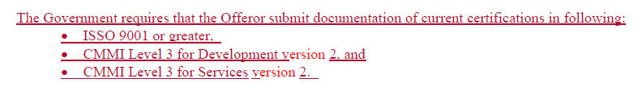
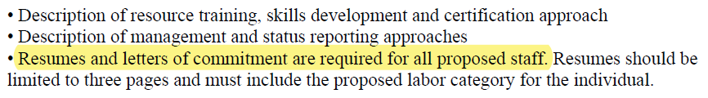
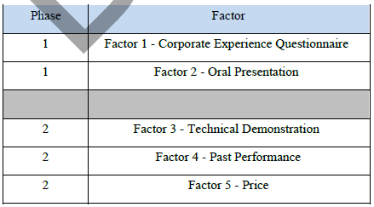
Examples from Real Proposals
Certifications and Q&A updates:
Abnormally large number of keys and/or resumes:
Double counting certain eval criteria

Slide 25
Section L (Instructions): Suggestions
  Procurements can attract quality bidders without over prescribing requirements. Ensure that major elements of Section L align with the evaluation criteria and are a realistic assessment of the scope, value, and complexity of the work.
  Share Section L with industry in the draft RFP prior to final RFP release. This assists companies with teaming, pricing, and solution strategy. It also provides an opportunity to share feedback related to alignment or perceived inconsistencies between sections; ultimately resulting in Gov’t receiving higher quality proposals.
  Vehicle and size/socioeconomic status is critical to teaming and preparation. Identify this early, share it, and limit changes. If changes are needed, provide extra time for companies to pivot.
  Understand that your potential Offerors will react and make decisions based upon the signals, whether intended or unintended, you send to industry.

Slide 26
5 Minute Break
  5 MINUTE
  BREAK

Slide 27
Section C: Description/Specifications/Statement of Work
Differences between SOW, PWS, and SOO
High
SOO
PWS
Collaborative
Pro: Encourages Innovation
Con: Lack of clarity
Response
Outcome-Based
Pro: Flexibility & Efficiency
Con: Balancing Performance & Cost
Contractor Input
SOW
Prescriptive
Pro: Clarity & Reduced Risk
Con: Limited Flexibility
Specificity of the Tasks
Low
High
Mixing elements of two or more of these approaches often results in confusion and questions from industry

Slide 28
Challenges and Impacts in Section C
Issue 1: Solicitation type does not match the needs of the procurement
  Highly complex solicitations often use an SOW or PWS rather than an SOO. This leads to unclear and/or overly prescribed requirements.
  With SOW and PWS, industry lacks flexibility to provide innovation or offer a different solution
  With SOW and PWS, CMS will have difficulty conducting trade off analysis and vendors will perceive price as the primary/only distinguishing factor
Issue 2: SOWs are leveraged in cases where Government and industry have not had enough engagement to understand the operating environment
  This makes solutioning a proposal response very difficult and can lead to undesirable responses in terms of technical approach and price.
Notes:
Best value starts at the end
How will the TEP make decisions?
Making it clear how you will make the tradeoffs - what does technically acceptable mean?
Start from the end - figure out how the TEP will score the proposals and then write the RFP based on that.
“Considerably more” - Tech is considerably more important than price—-ok, how much more important? How would you respond to that? Be very specific on the evaluation criteria
How will you explain your decision-making process to others in the agency, to GAO, to the vendors?
We also see it say considerably more than price, but price will be considered….signal that we need to lower prices, which typically means lower quality
for Best Value we need to talk about Corp Ex and PP. For them to feel like they are getting the best value we need to ensure they understand the vendor has the experience needed to complete the program.
Quantitative -
if the only thing that the contractors can quantify is price, then it essentially becomes LPTA
Baynard Institute
This goes both ways. —- Also, did the vendor provide quantitative examples to you? 3 vendors can provide 3 different ways to solve a problem—how are you going to evaluate that? Did they tell you how, specifically with numbers or a business model, their solution is better. For example, Lower cost of ownership. Customer software development vs something like Salesforce.
BGOV and Salesforce
got to market faster, got revenue faster
but total cost of ownership was way higher b/c of customization needed, changing licensing requirements, database costs, etc
North Star" defined and desired outcomes are listed that are not vague, but rather specific. Including these will help contractors shape proposals that are technically sound and address the issues head on and position contractors well for a fair evaluation that is one to one with expectations.
Regarding software, including a list of software that is currently being used would be helpful so that we do not play a guessing game and can actually answer to the optimization of what is being used currently or offer a better (maybe even less costly) solution. Ensuring that the tech stack in consistently included in the RFPs so that contractors can fully make a decision on whether the product is something that is within the contractor's wheelhouse.
Show don’t tell
If you can’t make it quantitative, consider a different type of procurement. - do a very brief proposal mainly focused on past performance and company experience and then do a design challenge for example.
“show, not tell” in a 3 minute video on the vendor’s process for solving complex problems and then a 4-hour technical challenge demonstrating their process and shipping working code.
Constraints
Tell us what your constraints are - we don’t always understand your constraints just like you don’t understand our constraints
Avoid protests, industry hates protests too
Section M (Evaluation Criteria) – 10 minutes (Donald and Kishore)
Technical Factors
Management Approach Factor
Past Experience or Corporate Experience
Personnel
Impact of procurement delay on ability to keep key personnel
Best Value Trade Off Analysis
What does technically acceptable mean?
What does “considerably more” mean?
How will you trade off?
How do you measure value?
Objective v. subjective criteria
Importance of Debrief to explain how decision was made. Companies protest when they can’t understand it or make sense of it.
Provides examples from RFPs to show differences

Slide 29
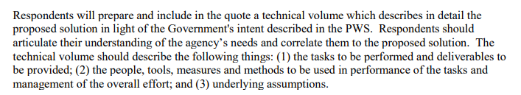
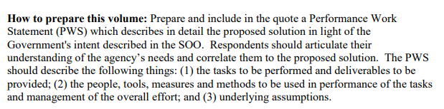
Challenges and Impact in Section C
Issue 3: Misunderstanding of the intent of a SOO
  Common to see SOO’s that are overly prescriptive and have the “look-and-feel” of a SOW or PWS with too many “Shall” statements
  One of the key benefits of an SOO is the ability for the industry to propose creative solutions. A highly prescriptive SOO can limit this benefit by dictating specific approaches that might not be the most efficient or effective.
Issue 4: Industry confusion in responding to a SOO with a PWS
  This leads to inconsistency in responses from Industry
Section C from the Government: PWS
Proposal Instructions for Industry:
Section C from the Government: SOO
Proposal Instructions for Industry:
Notes:
Best value starts at the end
How will the TEP make decisions?
Making it clear how you will make the tradeoffs - what does technically acceptable mean?
Start from the end - figure out how the TEP will score the proposals and then write the RFP based on that.
“Considerably more” - Tech is considerably more important than price—-ok, how much more important? How would you respond to that? Be very specific on the evaluation criteria
How will you explain your decision-making process to others in the agency, to GAO, to the vendors?
We also see it say considerably more than price, but price will be considered….signal that we need to lower prices, which typically means lower quality
for Best Value we need to talk about Corp Ex and PP. For them to feel like they are getting the best value we need to ensure they understand the vendor has the experience needed to complete the program.
Quantitative -
if the only thing that the contractors can quantify is price, then it essentially becomes LPTA
Baynard Institute
This goes both ways. —- Also, did the vendor provide quantitative examples to you? 3 vendors can provide 3 different ways to solve a problem—how are you going to evaluate that? Did they tell you how, specifically with numbers or a business model, their solution is better. For example, Lower cost of ownership. Customer software development vs something like Salesforce.
BGOV and Salesforce
got to market faster, got revenue faster
but total cost of ownership was way higher b/c of customization needed, changing licensing requirements, database costs, etc
North Star" defined and desired outcomes are listed that are not vague, but rather specific. Including these will help contractors shape proposals that are technically sound and address the issues head on and position contractors well for a fair evaluation that is one to one with expectations.
Regarding software, including a list of software that is currently being used would be helpful so that we do not play a guessing game and can actually answer to the optimization of what is being used currently or offer a better (maybe even less costly) solution. Ensuring that the tech stack in consistently included in the RFPs so that contractors can fully make a decision on whether the product is something that is within the contractor's wheelhouse.
Show don’t tell
If you can’t make it quantitative, consider a different type of procurement. - do a very brief proposal mainly focused on past performance and company experience and then do a design challenge for example.
“show, not tell” in a 3 minute video on the vendor’s process for solving complex problems and then a 4-hour technical challenge demonstrating their process and shipping working code.
Constraints
Tell us what your constraints are - we don’t always understand your constraints just like you don’t understand our constraints
Avoid protests, industry hates protests too
Section M (Evaluation Criteria) – 10 minutes (Donald and Kishore)
Technical Factors
Management Approach Factor
Past Experience or Corporate Experience
Personnel
Impact of procurement delay on ability to keep key personnel
Best Value Trade Off Analysis
What does technically acceptable mean?
What does “considerably more” mean?
How will you trade off?
How do you measure value?
Objective v. subjective criteria
Importance of Debrief to explain how decision was made. Companies protest when they can’t understand it or make sense of it.
Provides examples from RFPs to show differences

Slide 30
Impact of SOW, SOO, and PWS – Example
Government Need: The government agency needs to develop a new customer service portal to improve citizen engagement, provide self-service options, and streamline communication with various departments.
SOW | SOO | PWS
Expected Information from the Government
Objective: Develop a customer service portal to enhance citizen engagement and streamline communication. Performance Requirements: Portal should handle at least 10,000 concurrent users. | Objective: Enhance citizen engagement through a user-friendly customer service portal. Improve efficiency in handling citizen requests and communication. Performance Requirements: Portal must be user-friendly and accessible on various devices. High reliability and security standards. Compliance with accessibility and data protection regulations. | Objective: Develop a customer service portal that improves citizen engagement and operational efficiency. Performance Requirements: Portal must support at least 10,000 concurrent users. Average page load time under 3 seconds. Compliance with WCAG 2.1 accessibility standards. 99.9% uptime.
Expected Industry Response
Detailed proposal outlining the approach to meet each requirement. Project plan with timelines, milestones, and resource allocation. Description of technologies and tools to be used. Past performance and experience in similar projects. Cost estimate including development, testing, and maintenance phases. | Develop a PWS showing innovative design by defining the development approach requirements. Describe the work in terms of the required results rather than "how" the work is to be accomplished. Provide performance standards that measure user-friendliness, security, and accessibility. Cost estimate and timeline for project completion. | Detailed approach to meet performance standards and outcomes. Technologies and methodologies proposed. Timeline and resource allocation plan. Examples of past performance and similar projects. Cost breakdown for development, testing, deployment, and maintenance.

Slide 31
Section C: Description/Specifications/Statement of Work
Industry Expectations for SOW, SOO and PWS
Section C: Description/Specifications/Statement of Work
Industry Expectations for SOW, SOO and PWS
ElementAccepta | SOW | SOO | PWS
Project Objectives and Goals |  | ✓
Specific Tasks and Activities | ✓ |  | ✓
Deliverables and Milestones | ✓ |  | ✓
Timeline and Schedule; Resources and Materials; Personnel Requirements | ✓ |  | ✓
Acceptance Criteria; Reporting and Documentation | ✓ |  | ✓
Flexibility for Approach |  | ✓ | ✓
Performance Assessment Methods |  |  | ✓
Performance Standards and Metrics and Quality Expectations and Criteria | ✓ |  | ✓
Scope of Work | ✓ |  | ✓
Common Expectations
Clear Definitions; Budget and Cost Considerations; Risk Management; Evaluation and Selection Criteria; Legal and Compliance Requirements | ✓ | ✓ | ✓
Desired Outcomes and Results | ✓ | ✓ | ✓
Assumptions and Constraints | ✓ | ✓ | ✓

Slide 32
Suggestions in Section C
  Use an SOW or PWS when the Government wants to use the same approach and is not seeking something new.
  Give enough space to respond to all “Shalls”.
  Use a SOO when seeking innovation or a different way of operating so industry can propose how they will solve the problem or achieve the desired results
  Even O&M can involve innovation and require an SOO
    Example: The objective of this contract is to maintain and enhance our existing IT infrastructure with innovative AI-driven operations solutions. The goal is to improve operational efficiency, reduce downtime, and enhance predictive maintenance capabilities through advanced artificial intelligence and machine learning technologies.
  If using a SOO, consider including more direct guidelines on what should and should not be included in an Offeror’s PWS response to ensure clarity in how it is different from a technical approach narrative in response to a PWS or SOW
    Consider providing templates for the PWS and allow industry to provide a short (3-5 pages) executive summary to provide their solution approach and benefits that is not part of the actual PWS and not be included in the final contract

Slide 33
Section B: Supplies or Services and Prices/Costs
Section B: Supplies or Services and Prices/Costs
Industry Engagement and Clear Requirements
Challenge: The RFP does not include: enough information, clear requirements, or desired outcomes - impacting Industry’s ability to provide accurate pricing.
Market research focused on price structure
  RFIs and sources sought
  Industry engagement with various stakeholders within the agency, including acquisition professionals
  Ask directly what else is needed for Industry to accurately price
Provide clear technical and scoping requirements
  Levels the playing field, more critical on recompetes
  Clearly describe requirements or outcomes desired – without this Offerors will have a hard time estimating and pricing
  Make technical and business process documentation part of the market research and RFP phases

Slide 34
What is Price to Win (PTW)?
What is Price to Win (PTW)?
PTW is an estimated winning price based on a comprehensive assessment of the market, considering the Customer, Competition, and Company Capabilities.
Customer
It is critical for Industry to understand the agency for which they are submitting a bid
Basis of Award
Pricing Requirements
Budget
Price Pressures
Ceiling Protection
Does the agency award at a price premium? If so, how much?
Competition
Who else will most likely bid on the solicitation
Do they have a footprint at the agency?
Do they have a reputation for “buying” work?
What are their technical strengths?
How will they score on the evaluation criteria?
Capabilities
Understand your company’s strengths and weaknesses
Do we bring something unique that our competition does not?
Have we done this type of work elsewhere?
Do we have a deep understanding of the requirements and scope for delivery?

Slide 35
RFP Language that Influences PTW
RFP Language that Influences PTW
Relative Importance of Factors
The Government will evaluate quotes using a tradeoff process to determine which quote represents the Best Value to the Government, as defined in FAR 2.101 and described in FAR 8.405. The Government may award to other than the lowest priced quote or to other than the quote assessed the most non-price merit. The relative importance considering all evaluation factors is provided as follows: all evaluation factors other than cost or price, when combined, are significantly more important than cost or price
Industry Interpretation:
“When combined” makes it difficult to know where price lands as an individual factor in the best-value continuum
Change to Consider
Remove “when combined” language and add “Price as an individual factor is the lowest rated in order of importance.”
Publish a numerical scoring matrix with values tied to each factor ensuring price doesn’t steer the evaluation disproportionately or inappropriately.
Publish a price range that Offerors must price within – otherwise they will be deemed unrealistic or unreasonable.

Slide 36
RFP Language that Influences PTW
RFP Language that Influences PTW
“The Highest Technically Rated Offeror with a Fair and Reasonable Price (HTROFRP) approach will best achieve the objective awarding a contract to the Offeror whose qualities that are most important. Through the HTROFRP evaluation methodology, the Agency will consider the non-price factors, when combined, to be significantly more important than price. Further, if the proposal is found not to have a fair and reasonable price, it will be eliminated from the Agency’s ranking. There will be no tradeoff between the non-price factors and price.
All proposals will be initially reviewed for compliance to the submission requirements of the solicitation. Proposals deemed to meet the minimum submission requirements conforming to the solicitation will then be evaluated. Technical proposals will then be ranked based on the technical score from the highest to lowest.
The offeror with the highest technical score will then be verified. Only the highest technically rated offeror’s price proposal will be evaluated for fairness and reasonableness. If the highest technically rated offeror’s price proposal is determined to be fair and reasonable, then the Agency will award the contract. If the highest technically rated offeror’s price proposal is not found fair and reasonable, the Agency will exclude the offeror from further consideration and will move to the next-highest technically rated offeror’s proposal to conduct a price reasonableness determination. This process will continue until and offeror with a fair and reasonable price is determined.”
When your goal is to select a technically superior partner – this language will empower you to select the right awardee.
How Industry Analyzes and Responds to Best Value RFP

Slide 37

Impacts of Section B: Pricing for Innovative Solutions.
Impacts of Section B: Pricing for Innovative Solutions
Challenge: Agency states it wants innovative solutions, but Section B does not require innovation pricing requirements.
Example Evaluation Criteria from CMS RFQ
If you are seeking innovation in your scope, you MUST have evaluation criteria to evaluate it or industry will not include it.
  Consider use of a separate CLIN for Innovation scope that is a fixed price NTE plug number in the RFP that is added to all offerors proposed prices for other RFP CLINs. The NTE plug number would align to an RFP’s expected innovation effort.
  For technology related projects, ideally ask for Innovation in option year so the Vendor has had time to understand the need.
  This provides maximum flexibility during program performance to both the government and the offeror and provides an identified funding stream that allows for delivery of an innovation roadmap in support of the program’s mission.
How Industry Analyzes and Responds to Best Value RFP

Slide 38
Section B: Impact of Contract Type
Section B: Impact of Contract Type
Contract type can greatly impact industry's approach to pricing
 | FFP | T&M | CPFF
Positives | Cost certainty for the Government Incentivizes efficiency Simpler administration | Flexibility for scope changes Cost transparency to the gov't Reduced contractor risk | Encourages expertise and innovation without cost overrun risk Incentivizes completion
Challenges | Industry holds the financial risk Limited flexibility with scope changes Less attractive to industry if requirements are not well defined | Total cost can be unpredictable Potential for inefficiency Increased administration for the Gov't to track costs | Gov't has less control over total cost Less incentive for efficiency Pre-determined fee that does not adjust if costs increase
Bid/No-Bid Considerations | New IT development contracts – risky if scope is not well defined or understood Pricing by Agile Sprint – accurate estimation requires experience and understanding Responding to a SOO may be too high-level; industry may add to price to reduce risk and/or be heavy with assumptions | Most flexible for industry and reduces risk especially with new development programs More likely to see Industry get more competitive with price – can feel like a “race to the bottom” Understanding the competitive landscape is key in bid decisions More detailed SOW or PWS can help reduce the risk of scope creep | While there is more flexibility, if there are no clear performance metrics and well-defined scope, there is a risk for scope-creep; since fixed fee does not vary with cost, type of work will be considered in bid decisions Some small businesses may not have an approved accounting system

Slide 39
Multi Phase Evaluations
With careful planning, the down select process of a multi-phase evaluation can save significant time, money, and risk by reducing the effort, competition, and documentation for both government and industry.
While industry prefers to demonstrate abilities through oral evaluations and tech demonstrations, the cost to prepare and respond to those phases is high.
Suggestions:
  For Phase I, consider use of simple and inexpensive criteria such as certifications, past performance, or lessons learned, or a brief technical submission (no more than 5 pages) to determine eligibility for Phase II. Phases should move from easiest to hardest.
  For Phase I, keep response requirements simple and include the “must have” requirement(s) that are harder for certain vendors to address in later phases, (i.e., unique Key Personnel requirements, specific type of corporate experiences, or necessary certifications).
  If seeking innovation, consider criteria in Phase 1 that is not focused on corporate experience to enable opportunities for new entrants
  Encourage industry innovation during Market Research phase. Use the multi-phase process (with orals or demos) to evaluate it. When evaluating AI, orals and tech demonstrations require a real-world environment (e.g., internet)
  Small businesses may need more time to prepare after Phase I due to resource constraints. Consider asking how many weeks to allocate between Phases during market research phase. Ensure there is an opportunity for Q&A between Phase I and II.
  Limit the number of Key Personnel required for Orals; consider letting industry decide who to bring (e.g., best athlete approach)
  Evaluate whether a Phased Response is the right choice. Ask questions to industry during market research phase to determine if a Multi-Phase procurement will save time and money for either party.
Notes:
Best value starts at the end
How will the TEP make decisions?
Making it clear how you will make the tradeoffs - what does technically acceptable mean?
Start from the end - figure out how the TEP will score the proposals and then write the RFP based on that.
“Considerably more” - Tech is considerably more important than price—-ok, how much more important? How would you respond to that? Be very specific on the evaluation criteria
How will you explain your decision-making process to others in the agency, to GAO, to the vendors?
We also see it say considerably more than price, but price will be considered….signal that we need to lower prices, which typically means lower quality
for Best Value we need to talk about Corp Ex and PP. For them to feel like they are getting the best value we need to ensure they understand the vendor has the experience needed to complete the program.
Quantitative -
if the only thing that the contractors can quantify is price, then it essentially becomes LPTA
Baynard Institute
This goes both ways. —- Also, did the vendor provide quantitative examples to you? 3 vendors can provide 3 different ways to solve a problem—how are you going to evaluate that? Did they tell you how, specifically with numbers or a business model, their solution is better. For example, Lower cost of ownership. Customer software development vs something like Salesforce.
BGOV and Salesforce
got to market faster, got revenue faster
but total cost of ownership was way higher b/c of customization needed, changing licensing requirements, database costs, etc
North Star" defined and desired outcomes are listed that are not vague, but rather specific. Including these will help contractors shape proposals that are technically sound and address the issues head on and position contractors well for a fair evaluation that is one to one with expectations.
Regarding software, including a list of software that is currently being used would be helpful so that we do not play a guessing game and can actually answer to the optimization of what is being used currently or offer a better (maybe even less costly) solution. Ensuring that the tech stack in consistently included in the RFPs so that contractors can fully make a decision on whether the product is something that is within the contractor's wheelhouse.
Show don’t tell
If you can’t make it quantitative, consider a different type of procurement. - do a very brief proposal mainly focused on past performance and company experience and then do a design challenge for example.
“show, not tell” in a 3 minute video on the vendor’s process for solving complex problems and then a 4-hour technical challenge demonstrating their process and shipping working code.
Constraints
Tell us what your constraints are - we don’t always understand your constraints just like you don’t understand our constraints
Avoid protests, industry hates protests too
Section M (Evaluation Criteria) – 10 minutes (Donald and Kishore)
Technical Factors
Management Approach Factor
Past Experience or Corporate Experience
Personnel
Impact of procurement delay on ability to keep key personnel
Best Value Trade Off Analysis
What does technically acceptable mean?
What does “considerably more” mean?
How will you trade off?
How do you measure value?
Objective v. subjective criteria
Importance of Debrief to explain how decision was made. Companies protest when they can’t understand it or make sense of it.
Provides examples from RFPs to show differences

Slide 40
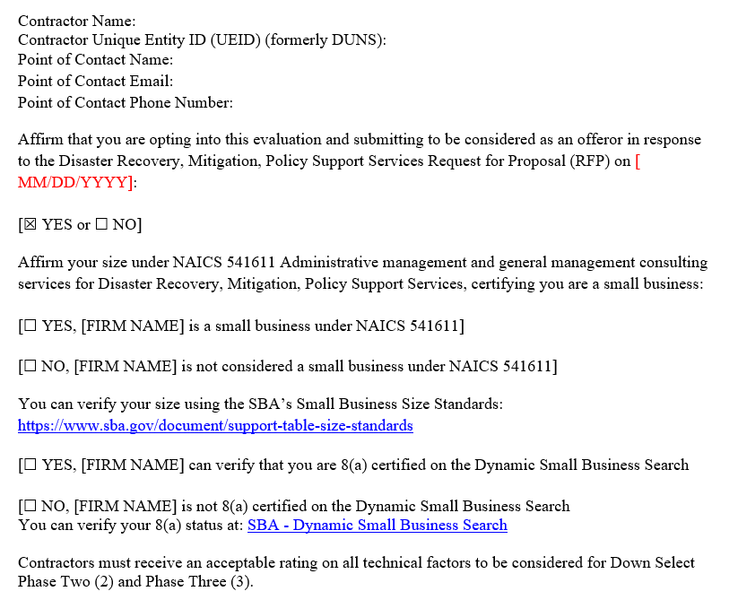
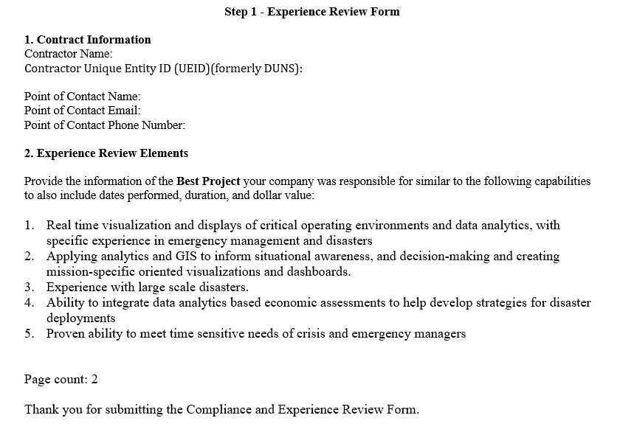
Multi Phase Evaluations
Phase I and Phase II Down Select (example to combine)
Prime or Team

Slide 41
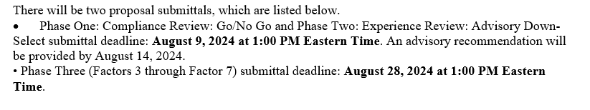
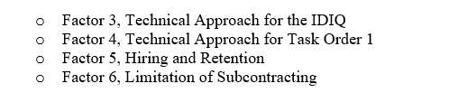
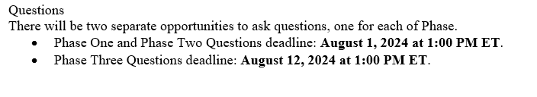
Multi Phase Evaluations
Phase I and Phase II Down Select (example to combine)
Time for Phase 1&2 vs Phase 3
Questions deadline is before down select.
Only 19 working days for heavy lift Phase 3

Slide 42
Q&A
Q&A

